Slide 1
Welcome to Eastern HS and MS OHSAA Preseason Sports Meeting

Slide 2
Please make sure to:
Parent and Athlete sign the sign in sheet
Silence cell phones
Pick up copy of season schedule
Pick up pay to participate form
Pick up Final Forms Instructions

Slide 3
Athletic Department Expectations
Represent Our School
Be a team player
Be a leader
Sportsmanship
Like Skills – Teamwork, dedication, commitment, problem solving, pride, effort, perseverance and responsibility

Slide 4
Changes for 2020-21
No weekly eligibility checks ..OHSAA requirements
You are responsible for your eligibility
If you need arrangements to ride home with another parent after athletic event..a note must be turned in to the principal or AD before the end of the school day. Notes will note be accepted at the athletic event.

Slide 5
Final Forms
All HS and MS athletes must be registered on final forms before participating in competition
All medical information is completed online
A physical form is printed off Final forms and completed by a physician and returned to the office secretaries.

Slide 8
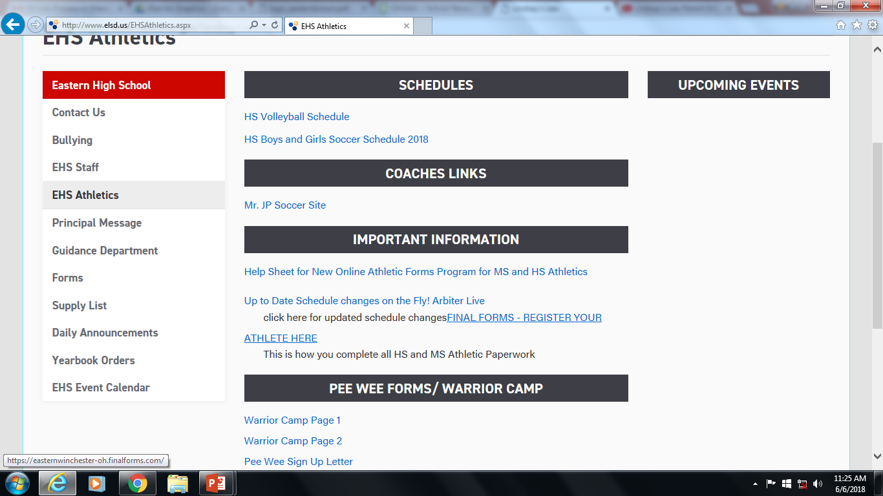

Slide 9
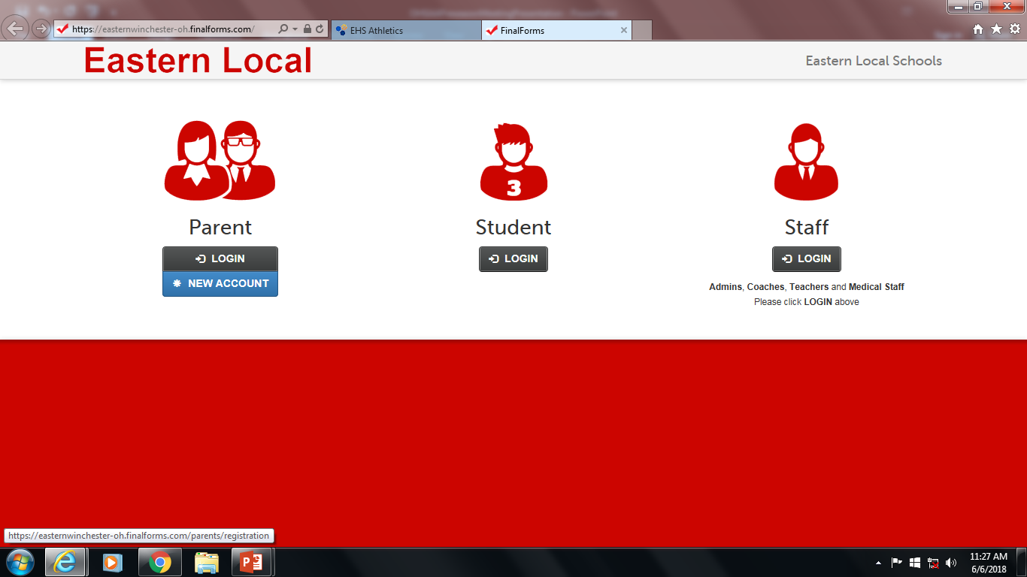

Slide 10
24 hour Rule and Chain of Commands Review
Any parent/player issue that arises from a game must not be addressed with the coach until 24 hours after the contest.
Schedule a meeting with the coach to discuss. “Emergencies are the exception”
Chain of Commands:
Coach AD Principal Superintendent
Always follow the Chain of Commands

Slide 11
Pay to Participate
Participation Fees for HS and MS Athletes
$100 per season
Must be Turned in before the first season game
Turn in to HS or MS Secretary
Participation fees does not guarantee playing time. Its pay to participate NOT pay to play.

Slide 12
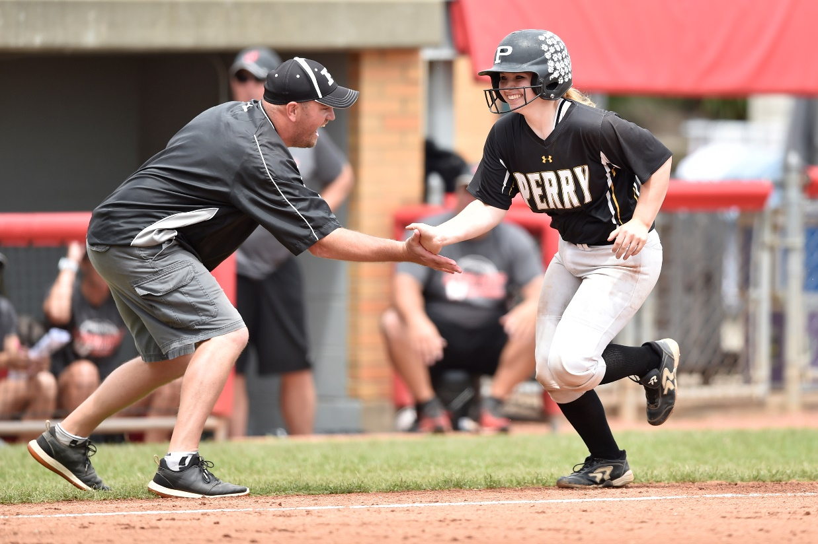
THE OHIO HIGH SCHOOL ATHLETIC ASSOCIATION
Information for
2021-22 Meetings

Slide 13
• Why Interscholastic Athletics &
OHSAA Beliefs
Participation in interscholastic athletics programs is educational in nature and:
• Complements your school experience.
• Fosters a sense of community and
teaches lifelong lessons of hard work,
teamwork, citizenship and discipline.
• Promotes a lifetime appreciation for
sports and healthy lifestyles.

Slide 14
• Why Interscholastic Athletics &
OHSAA Beliefs
Participation in interscholastic athletics programs:
• Helps prepare you for the next level of
your life as a responsible adult and
productive citizen. Interscholastic
athletics programs are not designed to
prepare you for the next level of
sports.

Slide 15
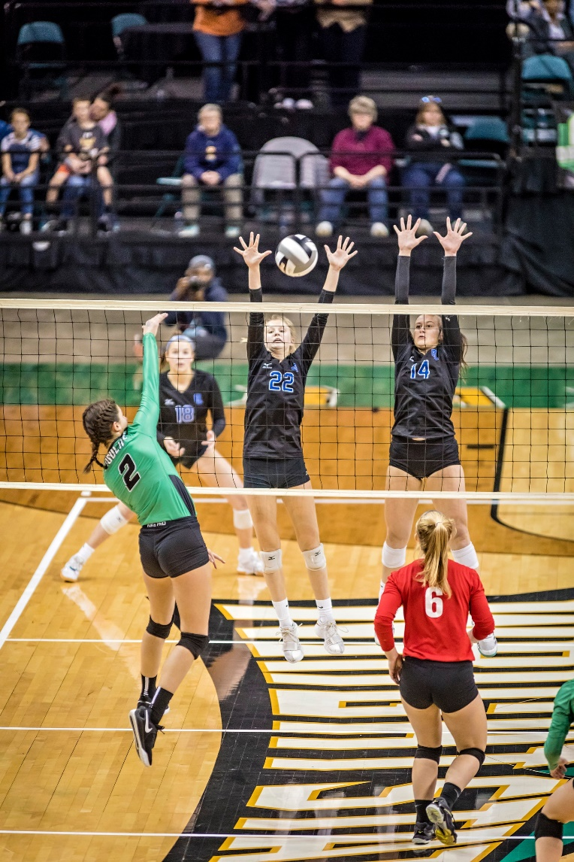
Basic OHSAA Rules & Regulations

Slide 16
• General OHSAA Eligibility Standards
Eligibility rules exist to help maintain competitive balance in school sports and to promote the purpose of education-based athletics.
As a student-athlete, YOU are primarily responsible
for your compliance.
Besides OHSAA regulations, your school also has the authority to establish additional academic standards and codes of conduct.

Slide 17
• General OHSAA Eligibility Standards
In order to maintain eligibility, you must be officially enrolled in an OHSAA member school, or participating in accordance with state law, and you must ﻿have a biological and/or adoptive parent who lives in Ohio.
You shall not be eligible if you are competing under a false name or have provided your school with an incorrect home address.
You may not be eligible if you have been recruited to attend this school.

Slide 18
• OHSAA Scholarship Standards
All incoming ninth graders must have received passing grades in a minimum of five subjects in the immediately preceding grading period. All grades must be recorded in a student’s academic record.
To maintain eligibility, high school students must have received passing grades in a minimum of five one-credit courses, or the equivalent, in the immediately preceding grading period.

Slide 19
• OHSAA Scholarship Standards
All incoming seventh graders are eligible insofar as the scholarship bylaw regardless of previous academic achievement.
To maintain eligibility, 7th-8th grade students must have received passing grades in a minimum of five classes in the immediately preceding grading period.

Slide 20
• OHSAA Scholarship Standards
To attempt to regain OHSAA eligibility, summer school grades, College Credit Plus and other educational options (e.g. work permitted after the conclusion of the grading period) shall not be used to bring a student into compliance with the OHSAA scholarship bylaws, nor can they be used to compensate for the lack of courses taken in the preceding grading period.
If you drop a course or change your schedule, it is critically important that you contact your principal or athletic administrator to see if this affects your eligibility.
The OHSAA has no minimum grade point (GPA) requirement, thus issues regarding eligibility when only the state-mandated GPA is of concern are strictly a local school district matter and not an OHSAA matter.

Slide 21
• OHSAA Semester Standards
No high school student will be eligible if he or she has been enrolled in high school for more than eight semesters.
No 7th-8th grade student will be eligible if he or she has been enrolled in 7th-8th grade for more than four semesters.

Slide 22
• OHSAA Age Standards
High school students will be ineligible whenever they turn 20 years old.
Seventh- and eighth-grade students who turn 15 before August 1st are also ineligible for 7th and 8th grade sports but MAY BE eligible to participate in high school athletics.

Slide 23
• OHSAA Non-School Team and Program &
Out-of-Season Standards
You will be ineligible if you are a member of a school team competing on a non-school team in the same sport during your school team’s season (example: club soccer team during school’s soccer season).
Coaches and schools cannot require that you participate in an open gym/open facility OR in a conditioning or instructional program. Violations of this regulation will result in penalties.

Slide 24
• OHSAA Non-School Team and Program &
Out-of-Season Standards
There are certain restrictions regarding tryouts, practices and competitions with non-school teams before, during and after the school season.
There are also restrictions for instruction you can receive from school coaches outside of your season in an OHSAA team sport (baseball, basketball, field hockey, football, ice hockey, lacrosse, soccer, softball and volleyball) and some OHSAA individual sports (cross country, track & field and wrestling).
There are no restrictions for instruction you can receive from school coaches outside of your season in many OHSAA individual sports (bowling, golf, gymnastics, swimming & diving and tennis).

Slide 25
• OHSAA Amateur Standards
You could lose your amateur status and forfeit your eligibility if you compete for money or other monetary compensation OR capitalize on your athletic fame by receiving money, merchandise or services or by entering into an agreement with a professional team or agent.

Slide 26
• OHSAA Transfer Standards
Once eligibility has been established at a member high school, a transfer to a different high school may mean you will lose eligibility for interscholastic athletics for a period of time at your new school. For specifics on the period of ineligibility, visit www.ohsaa.org.
This regulation has several exceptions, most of which require a ruling from the OHSAA Executive Director’s Office.

Slide 27
• OHSAA Transfer Standards
Should you have transferred to this school, you must ensure all applicable paperwork has been submitted to the OHSAA AND the state office has granted approval for eligibility.
Full eligibility will be granted only if one of the exceptions to the OHSAA transfer regulation has been met.

Slide 28
• General OHSAA Eligibility Standards
There ARE exceptions to some OHSAA regulations. If you believe you qualify for an exception or you have questions pertaining to your eligibility or about any of the regulations, please consult with your school principal or athletic administrator.
Ask your school principal or athletic administrator to discuss any unresolved issues with the administrators in the OHSAA office who handle eligibility issues.
You can also review all OHSAA regulations on eligibility standards by going to the OHSAA website at www.ohsaa.org.

Slide 29
Your Health & Safety

Slide 30
• Your Health & Safety
Before the season’s first practice (or prior to your first participation should you join the team after the season has started), you must have had a physical examination within the past year AND an examination clearance form must be on file at the school.
Physical examinations are valid for 13 months from the date of the exam. Exams taking place from May 1 to June 1 are valid for one year plus through the end of the next school year’s spring season.

Slide 31
• Your Health & Safety
Athletic participation forms shall be signed by a medical examiner (Physician [M.D., D.O. or D.C.], Advanced Nurse Practitioner or Physician’s Assistant), the participant and by a parent or guardian.
In addition, you will not be eligible unless you and your parents have signed the OHSAA Authorization Form; the OHSAA Eligibility & Authorization Statement; the Ohio Department of Health’s (ODH) concussion form, and ODH’s sudden cardiac arrest form, all of which must be on file at your school.

Slide 32
• Concussions
It is EXTREMELY important for everyone involved in school sports to recognize the potential dangers associated with concussions and review their responsibilities in protecting student-athletes.
Concussions are NOT just a problem in football . . . concussions can happen in just about any sport!
A concussion is a traumatic brain injury that interferes with normal function of the brain. “Dings” and “bell ringers” are SERIOUS brain injuries and you do NOT have to have loss of consciousness for it to be considered serious. Young athletes are at increased risk for serious problems.

Slide 33
• Concussions
In Ohio, any athlete who exhibits signs, symptoms, or behaviors consistent with a concussion . . . such as loss of consciousness, headache, dizziness, confusion or balance problems . . . shall be IMMEDIATELY removed from the contest or practice and shall not return to play that same day.
Thereafter, the student shall not return to practice or competition until cleared with WRITTEN AUTHORIZATION from a physician or health care provider approved by the local board in accordance with state law.

Slide 34
• Concussions
Each school is required to review its concussion management protocol with participants and their parents.
In addition, participants and parents must review and sign the Ohio Department of Health’s “Concussion Information Sheet” prior to participation and are highly encouraged to review a short presentation on concussions available at no cost (www.nfhslearn.com).

Slide 35
• Concussions
While return-to-play policies are very important, parents must also work with school administrators and teachers in developing concussion management guidelines for student-athletes who have been concussed and are returning to the classroom (i.e. Return to Learn).

Slide 36
• Sudden Cardiac Arrest
Sudden Cardiac Arrest (SCA) is the most common cause of death among student-athletes, and dizziness, loss of breath and a racing heart are often symptoms that are overlooked. In many cases, recognizing the signs of cardiac trouble means student-athletes can continue their athletic participation.
Participants and parents are required to view the Ohio Department of Health’s sudden cardiac arrest video that may be shown at your school.
In addition, participants and parents must review and sign the Ohio Department of Health’s “Sudden Cardiac Arrest Information Sheet” prior to participation.

Slide 37
• Additional Health & Safety Guidelines
The OHSAA does not permit the use of any form of alcohol, tobacco (including electronic cigarettes) or illegal drugs.
Besides the health risks involved, use of any of these items will result in students being disqualified from contests and violators likely facing additional school and legal penalties.

Slide 38
• Additional Health & Safety Guidelines
Another prominent issue is the use of performance enhancing supplements.
The increased availability of these items allows students easy access to a wide variety of products aggressively marketed to include promises — endorsed by faulty research claims — of extraordinary weight loss, explosive power or tremendous strength gains.
It is important for parents to educate themselves about what substances their child may be using and about the potential risks involved with uneducated supplement use.

Slide 39
• Additional Health & Safety Guidelines
Beyond performance enhancing supplements, there are additional issues related to illicit drugs, such as anabolic steroids and some prescription drugs used with the goal of aiding performance.
Use of these drugs will result in disqualification from all interscholastic athletics.

Slide 40
Sporting Behavior

Slide 41
• Respect The Game
The OHSAA’s vision for positive sporting behavior is built on expectations. It calls on the school community — administrators, contest officials, coaches, students, parents and fans — to strive for positive sporting behavior in everything they do by teaching the values of ethics, integrity, equity, fairness and respect.
As a student-athlete, you must always remember to Respect The Game!

Slide 42
• Respect The Game
That means you are expected to accept the responsibility and privilege of representing your school and community while participating in school sports. You are expected to:
• Treat opponents, coaches and officials with
respect.
• Ensure that your actions do not incite fans or
other participants or attempt to embarrass,
ridicule or demean others.

Slide 43
Sudden Cardiac Arrest Video
Go to this link to Watch Video:
https://youtu.be/s-YfCWQPeqw

Slide 44
Communicaton
Jerod.Jodrey@elsd.us
Facebook: Eastern Local Sports Brown County Ohio
Twitter: EHS EMS Athletics @ADEHSEMS
Schedules: On School Website under EHS and EMS Athletics

Slide 45
Go Warriors!!!

